Slide 1
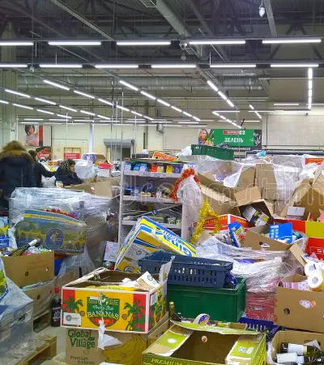
Retail Shelf Image Prediction using Computer Vision
Data 690:Pratical Deep Learning Professor: Weizhe Li
TEAM MEMBERS Amrita Chandrasekar(NH53017) Yeshwanth Rayankula(PS07211)

Slide 2
INTRODUCTION
Project Goals:
Enhance Inventory Management: Automatically identify and count products on shelves, reducing manual labor and errors.
Optimize Product Placement: Analyze which products are frequently picked up but not purchased, potentially adjusting their placement for better sales.
Why this Project:
Operational Excellence and Efficiency: This project employs advanced computer vision and deep learning to automate inventory management in retail, enhancing accuracy and reducing manual labor. This automation extends to optimizing store layouts and improving loss prevention, driving operational efficiencies and better resource allocation.
Enhanced Customer Experience and Data-Driven Insights: By ensuring product availability and optimizing in-store experiences through intelligent data analysis, the project aims to boost customer satisfaction and loyalty.

Slide 3

OBJECTIVES
To identify and classify grocery items into three main categories such as fruits, vegetables, and packaged goods by building deep learning models and Pytorch.
Use Fast R CNN to detect images from retail shelves.

Slide 4
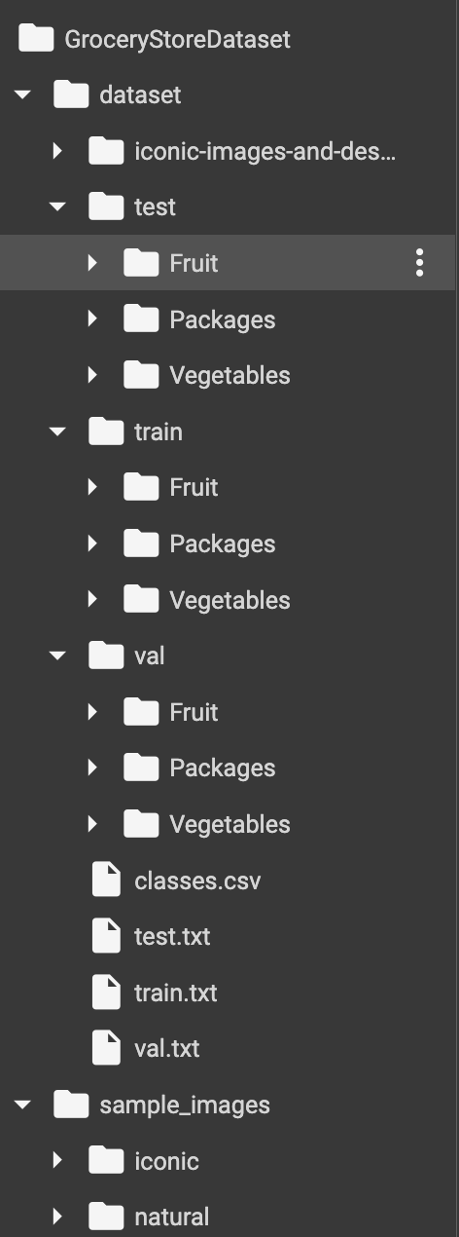
DATA COLLECTION
The dataset is taken from https://www.kaggle.com/datasets/validmodel/grocery-store-dataset
The dataset consists of 3 classes fruits, vegetables, packages
There are 5125 images
There are labels associated with each images

Slide 5
DATASET DESCRIPTION
Fruits
Train, Test, and Validation sets of around 2640 images
Packages
Train, Test, and Validation sets of around 296 images
Vegetables
Train, Test, and Validation sets of around 2485 images
Types of Fruits
Apple, Avocado, Banana, Kiwi, Lemon, Lime, Mango, Cantaloupe, Galia-Melon, Nectarine, Orange, Papaya, Passion-Fruit, Peach, Kaiser, Pineapple, Plum, Pomegranate, Red-Grapefruit, Satsumas, Watermelon, Honeydew Melon, Anjou, Conference Types of Vegetables
Asparagus, Aubergine, Cabbage, Carrots, Cucumber, Garlic, Ginger, Leek, Mushroom, Onion, Pepper, Potato, Red Beet, Tomato, Zucchini
Types of Packages in Data Set
Juice, Milk, Outghurt, Oat-Milk, Sour-Cream, Sour-Milk, Soyghurt, Soy-Milk, Yogurt

Slide 6
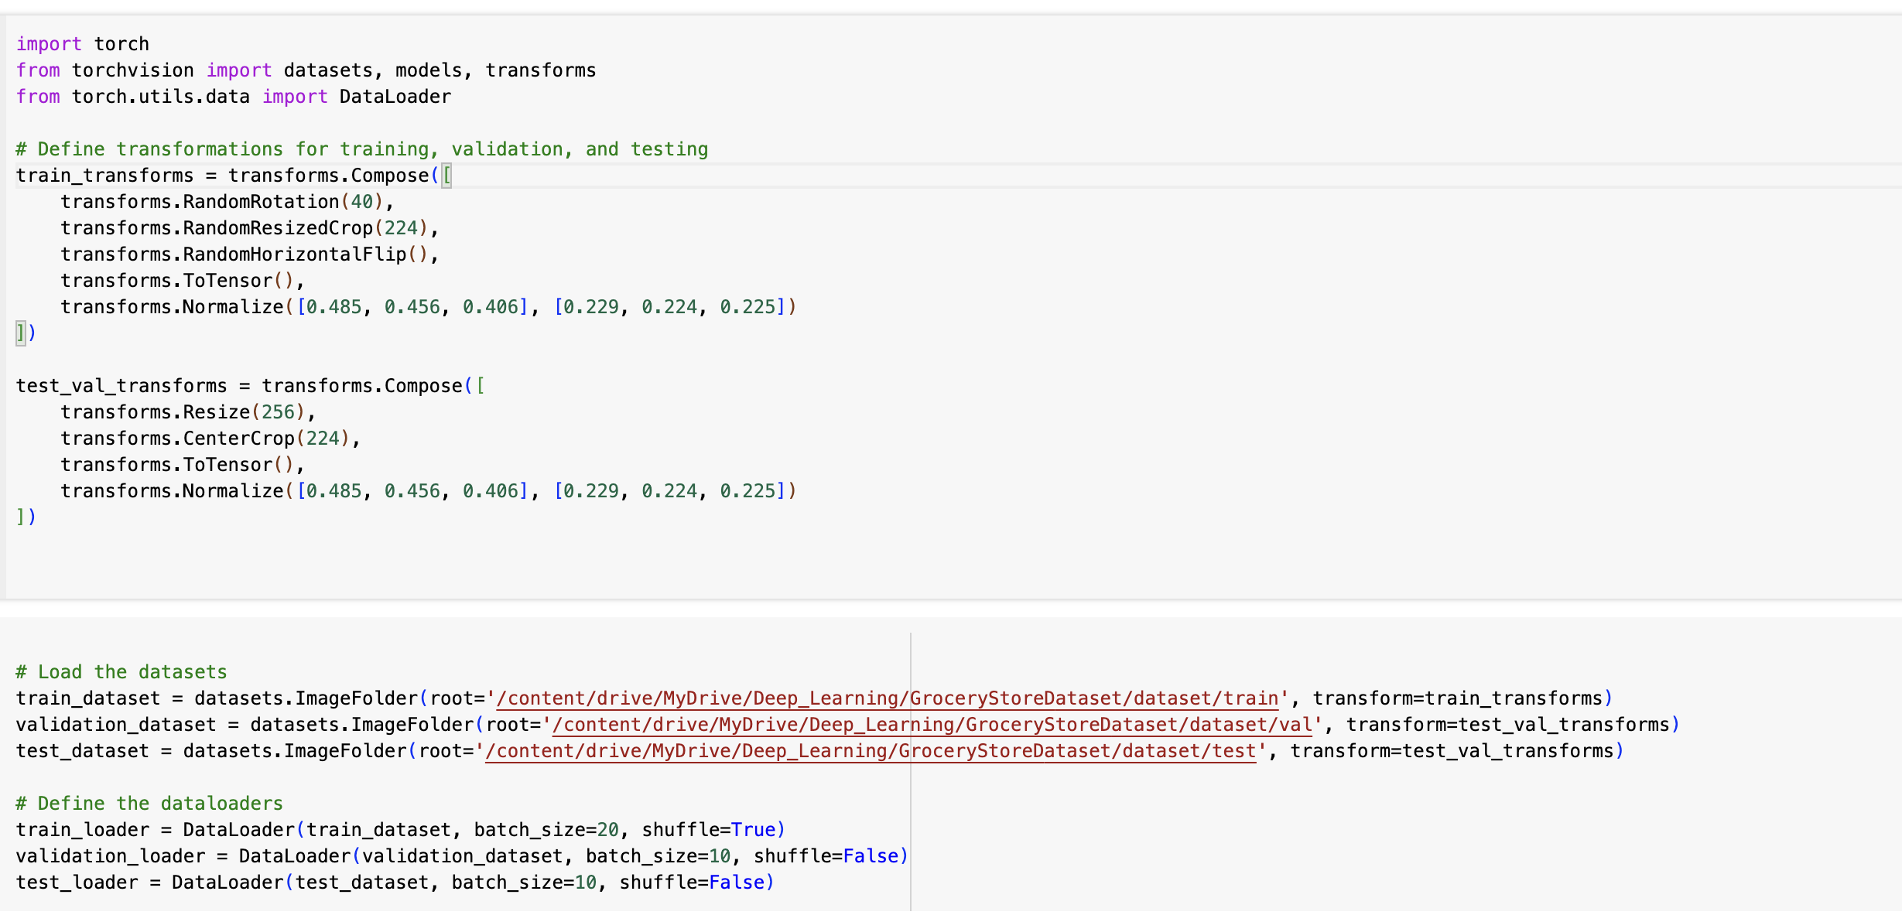
DATA LOADING AND AGUMENTATION

Slide 7

MODELS USED FOR CLASSIFICATION
Resnet
GoogleNet
DenseNet

Slide 8
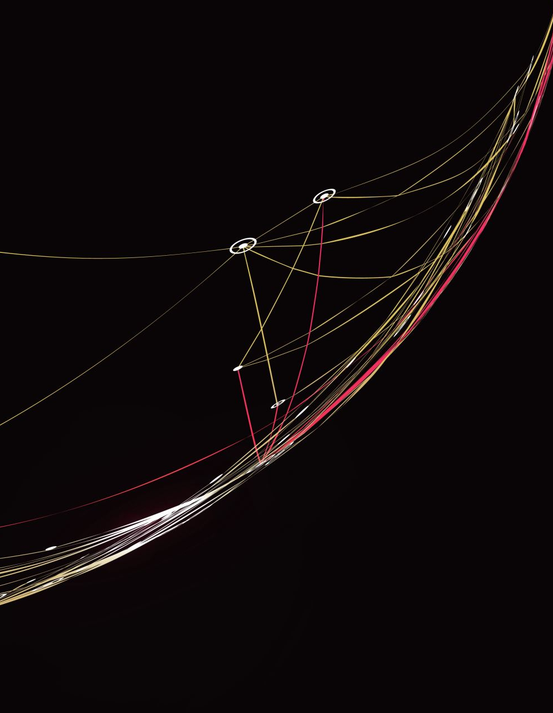
ResNet50Architecture Details:
ResNet, which stands for Residual Network, makes use of skip connections or shortcuts to jump over certain layers in the network. These layers may consist of convolutional layers, batch normalization, and ReLU activations.
The ability to skip some layers helps in overcoming the vanishing gradient problem, which allows the model to learn efficiently from a very deep network of layers.
Customization: The original fully connected layer was replaced with a new linear layer which provides an output to match the number of classes in the grocery dataset (Fruits, Packages, Vegetables).
The parameters in the pre-trained layers were kept unchanged during the training process, so only the weights in the new fully connected layer were updated.
To achieve this, the model was trained with a learning rate of 0.0001 using RMSprop optimizer. The model showed a continuous decrease in loss and improvement in accuracy with every epoch, indicating effective learning and adaptation to the grocery dataset.

Slide 9
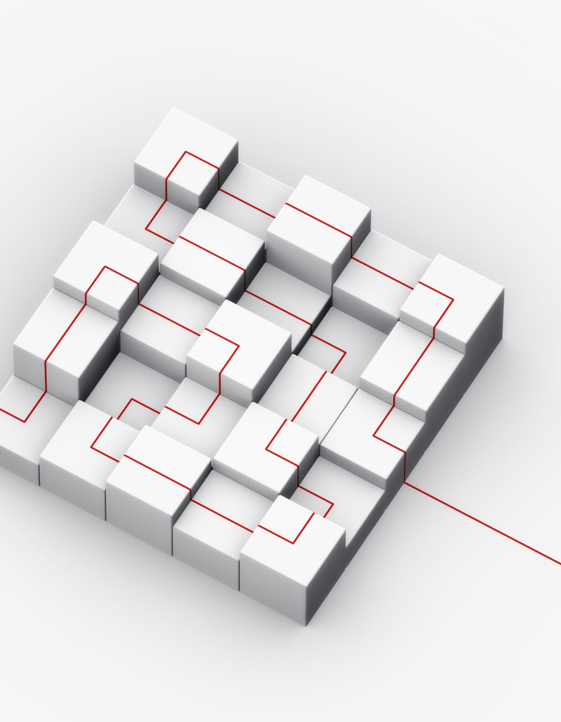
GoogleNet Architecture Details :
The following text describes the features, customization, and performance metrics of a neural network model. The model incorporates inception modules that use filters of different sizes to capture information at various scales.
Instead of fully connected layers, the model uses average pooling at the top of the network, which significantly reduces the number of parameters.
The output layer, originally a 1000-way softmax layer, can be replaced with a linear layer to match the number of classes specific to your dataset.
The pretrained network's parameters were frozen, similar to ResNet50, allowing the training to focus on the new output layer.
The model was optimized using the Adam optimizer with a learning rate of 0.001. It has demonstrated high precision and recall across the classes, with particularly strong performance in distinguishing packaged goods.

Slide 10

DenseNet Architecture Details:
The DenseNet121 Architecture is comprised of densely connected layers where each layer is connected to every other layer in a feed-forward fashion.
This means that for each layer, the feature maps of all preceding layers are used as inputs, and its feature maps are used as inputs into all subsequent layers, significantly improving the network's efficiency.
The classifier part of the network was customized to predict the three classes in the grocery dataset, utilizing feature maps from previous layers extensively, making the network quite robust at feature extraction even from complex images.
For performance metrics, we utilized Adam optimizer with a learning rate of 0.001, focusing on detailed feature extraction given Dense Net's architectural benefits.
The network achieved very high validation accuracies, with particularly impressive results in handling class imbalances and intricate patterns in the dataset.

Slide 11
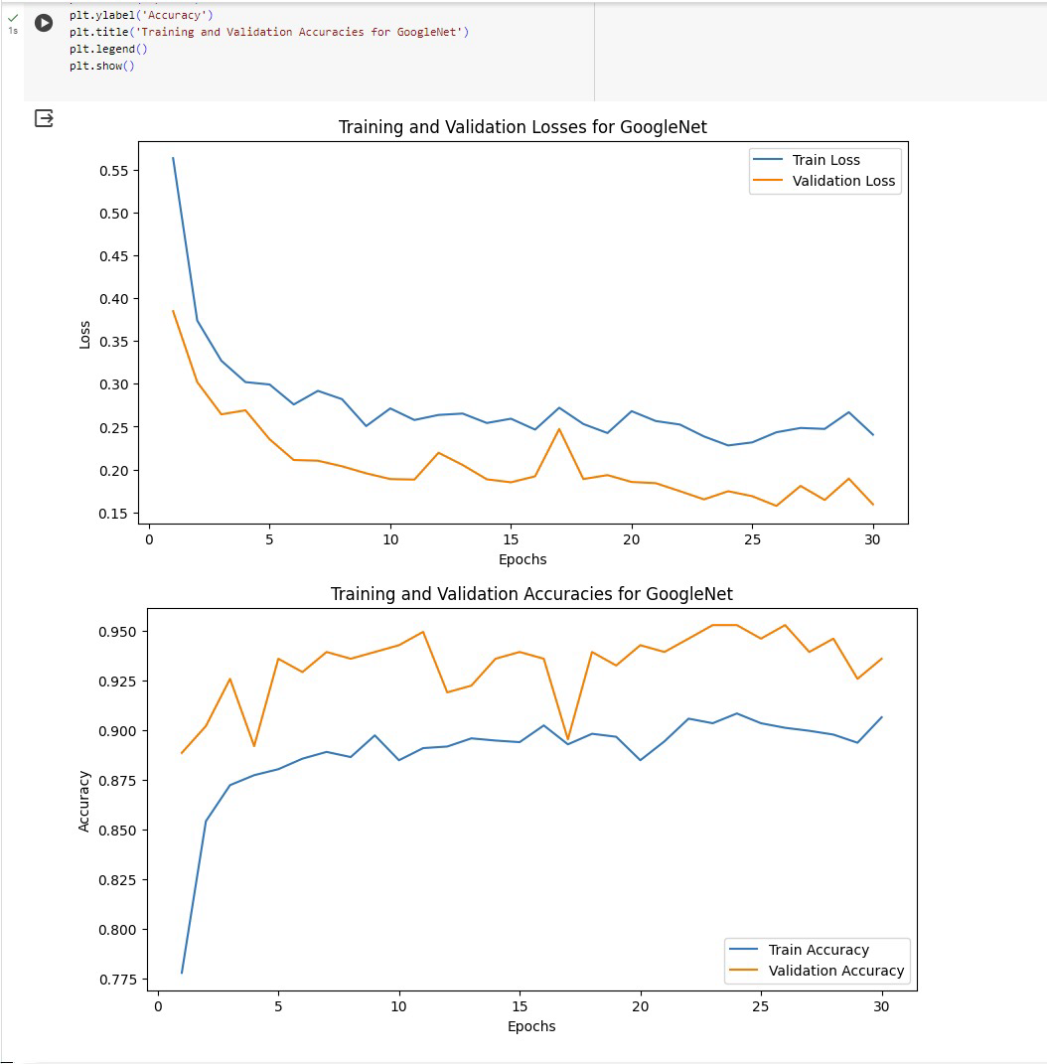
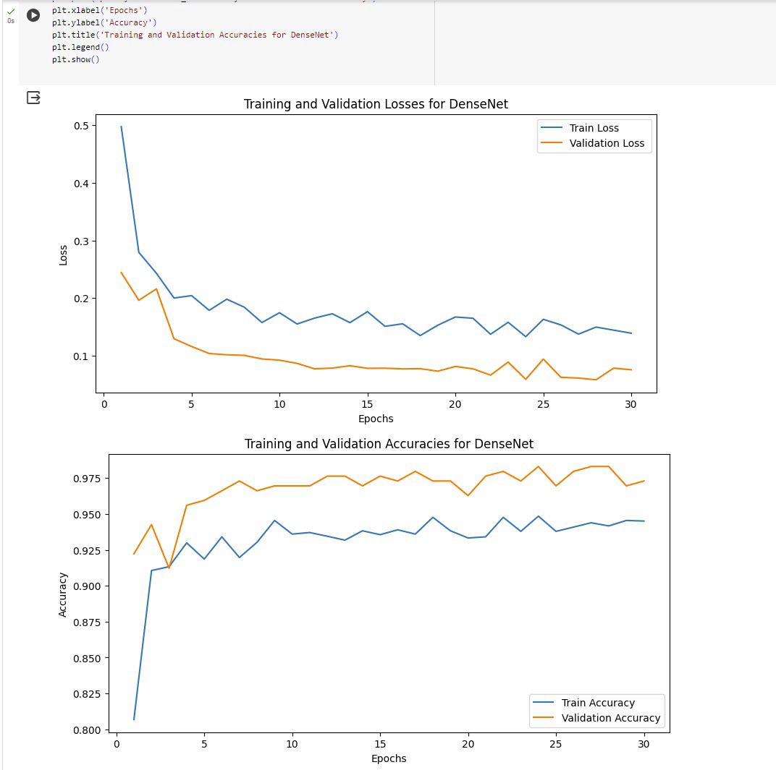
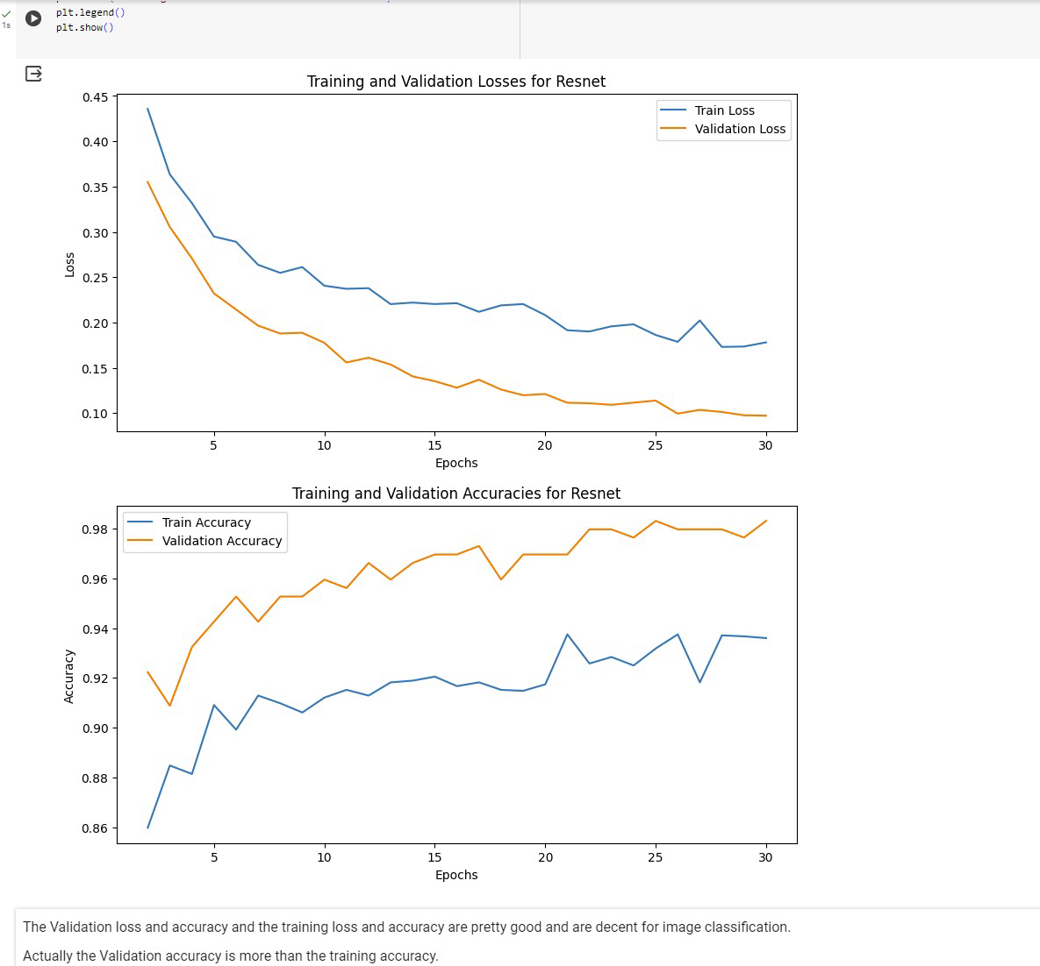
EXPLORATORY DATA ANLAYSIS

Slide 12
Training and Validation Results
Model | Resnet | Google Net | Dense Net
Training Accuracy | 93.60 | 90.38 | 94.51
Validation Accuracy | 98.31 | 93.58 | 97.30

Slide 13
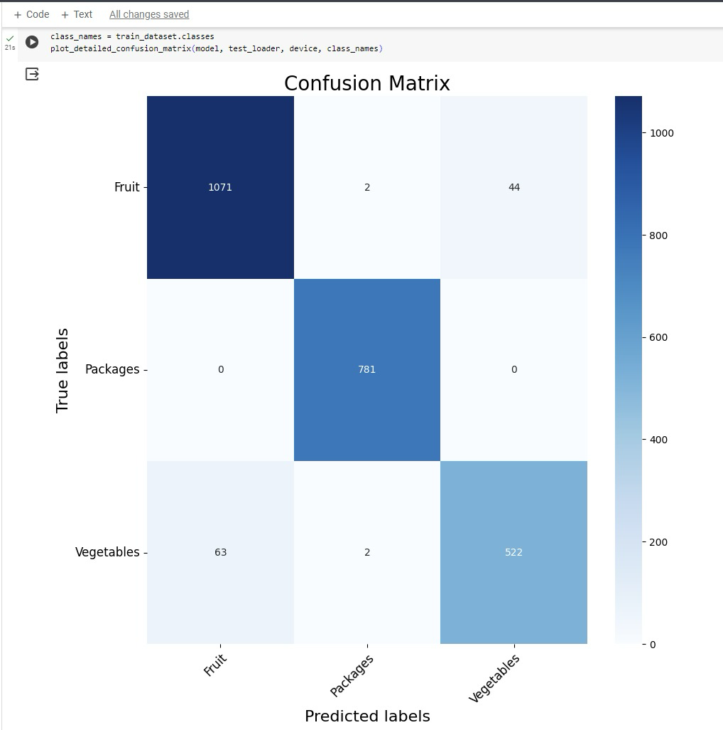
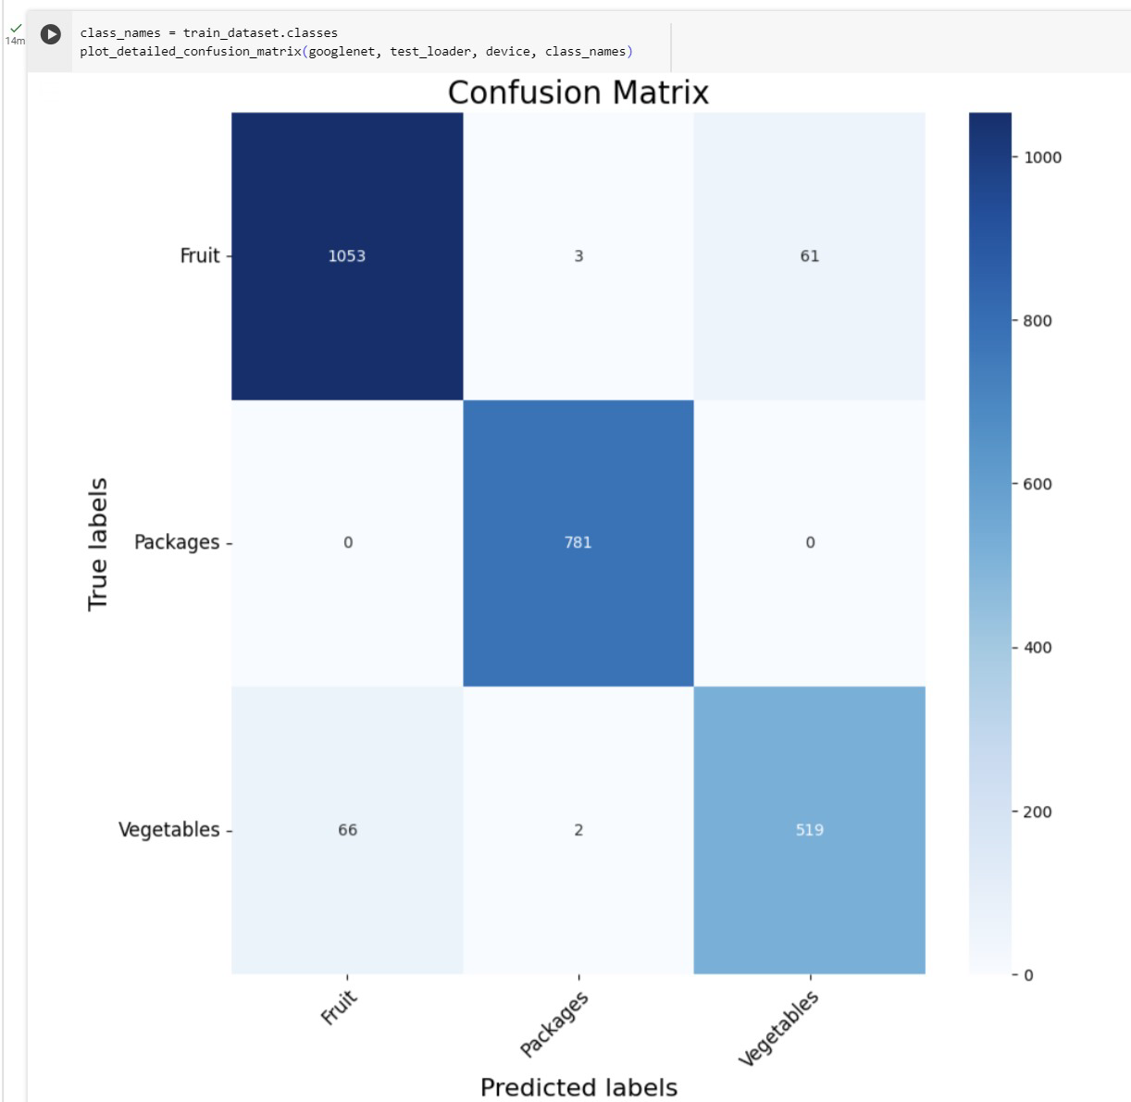
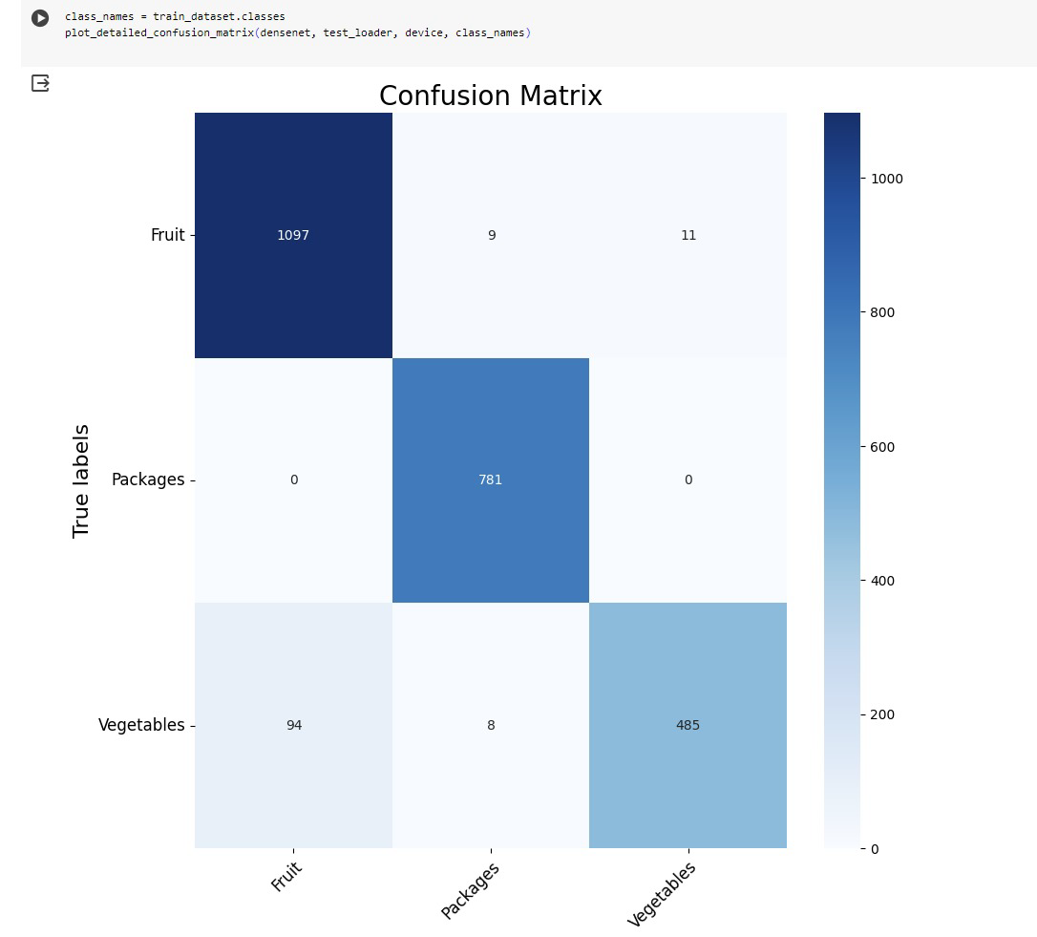
CLASSIFICATION OF IMAGES

Slide 14
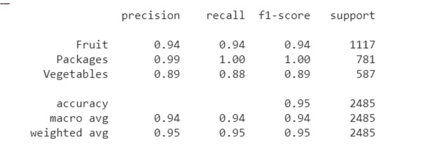
MODEL EVALUATION RESULTS

Slide 15
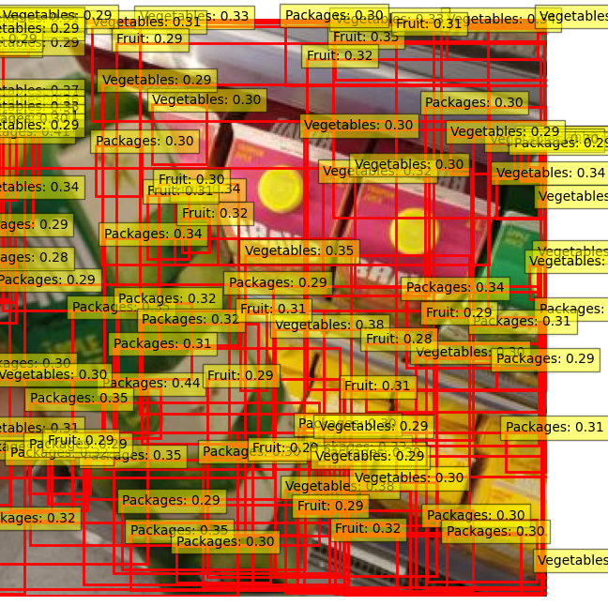
OBJECT DETECTION USING FAST R CNN

Slide 16
CONCLUSION
Effectively demonstrated the use of deep learning models like ResNet50 and DenseNet121 in automating the detection and classification of grocery items. The models were adept at handling various grocery products under various conditions.
While the object detection models demonstrated high accuracy in statistical evaluations, they visually failed to consistently and accurately localize grocery items in practical scenarios. This highlights a need for further optimization of the model to better handle real-world complexities found in grocery store environments.

Slide 17
FUTURE SCOPE
Void Detection for Restocking:
One of the forward-looking aspects of this project is to integrate void detection capabilities, which will continuously monitor shelf spaces to identify and flag empty or nearly empty shelves. This enables timely restocking actions, ensuring that no item runs out of stock and sales opportunities are maximized. It also aids in maintaining optimal inventory levels, which is crucial for efficient store management.
Item Identification and Shelf Clustering:
Future enhancements could include the development of algorithms capable of identifying items placed on incorrect shelves and categorizing them through clustering techniques. This can improve the shopping experience by ensuring that items are well-organized and easy to find. Moreover, it can assist in optimizing store layouts based on shopping patterns, leading to a more intuitive shopping environment that can drive sales and customer satisfaction.

Slide 18
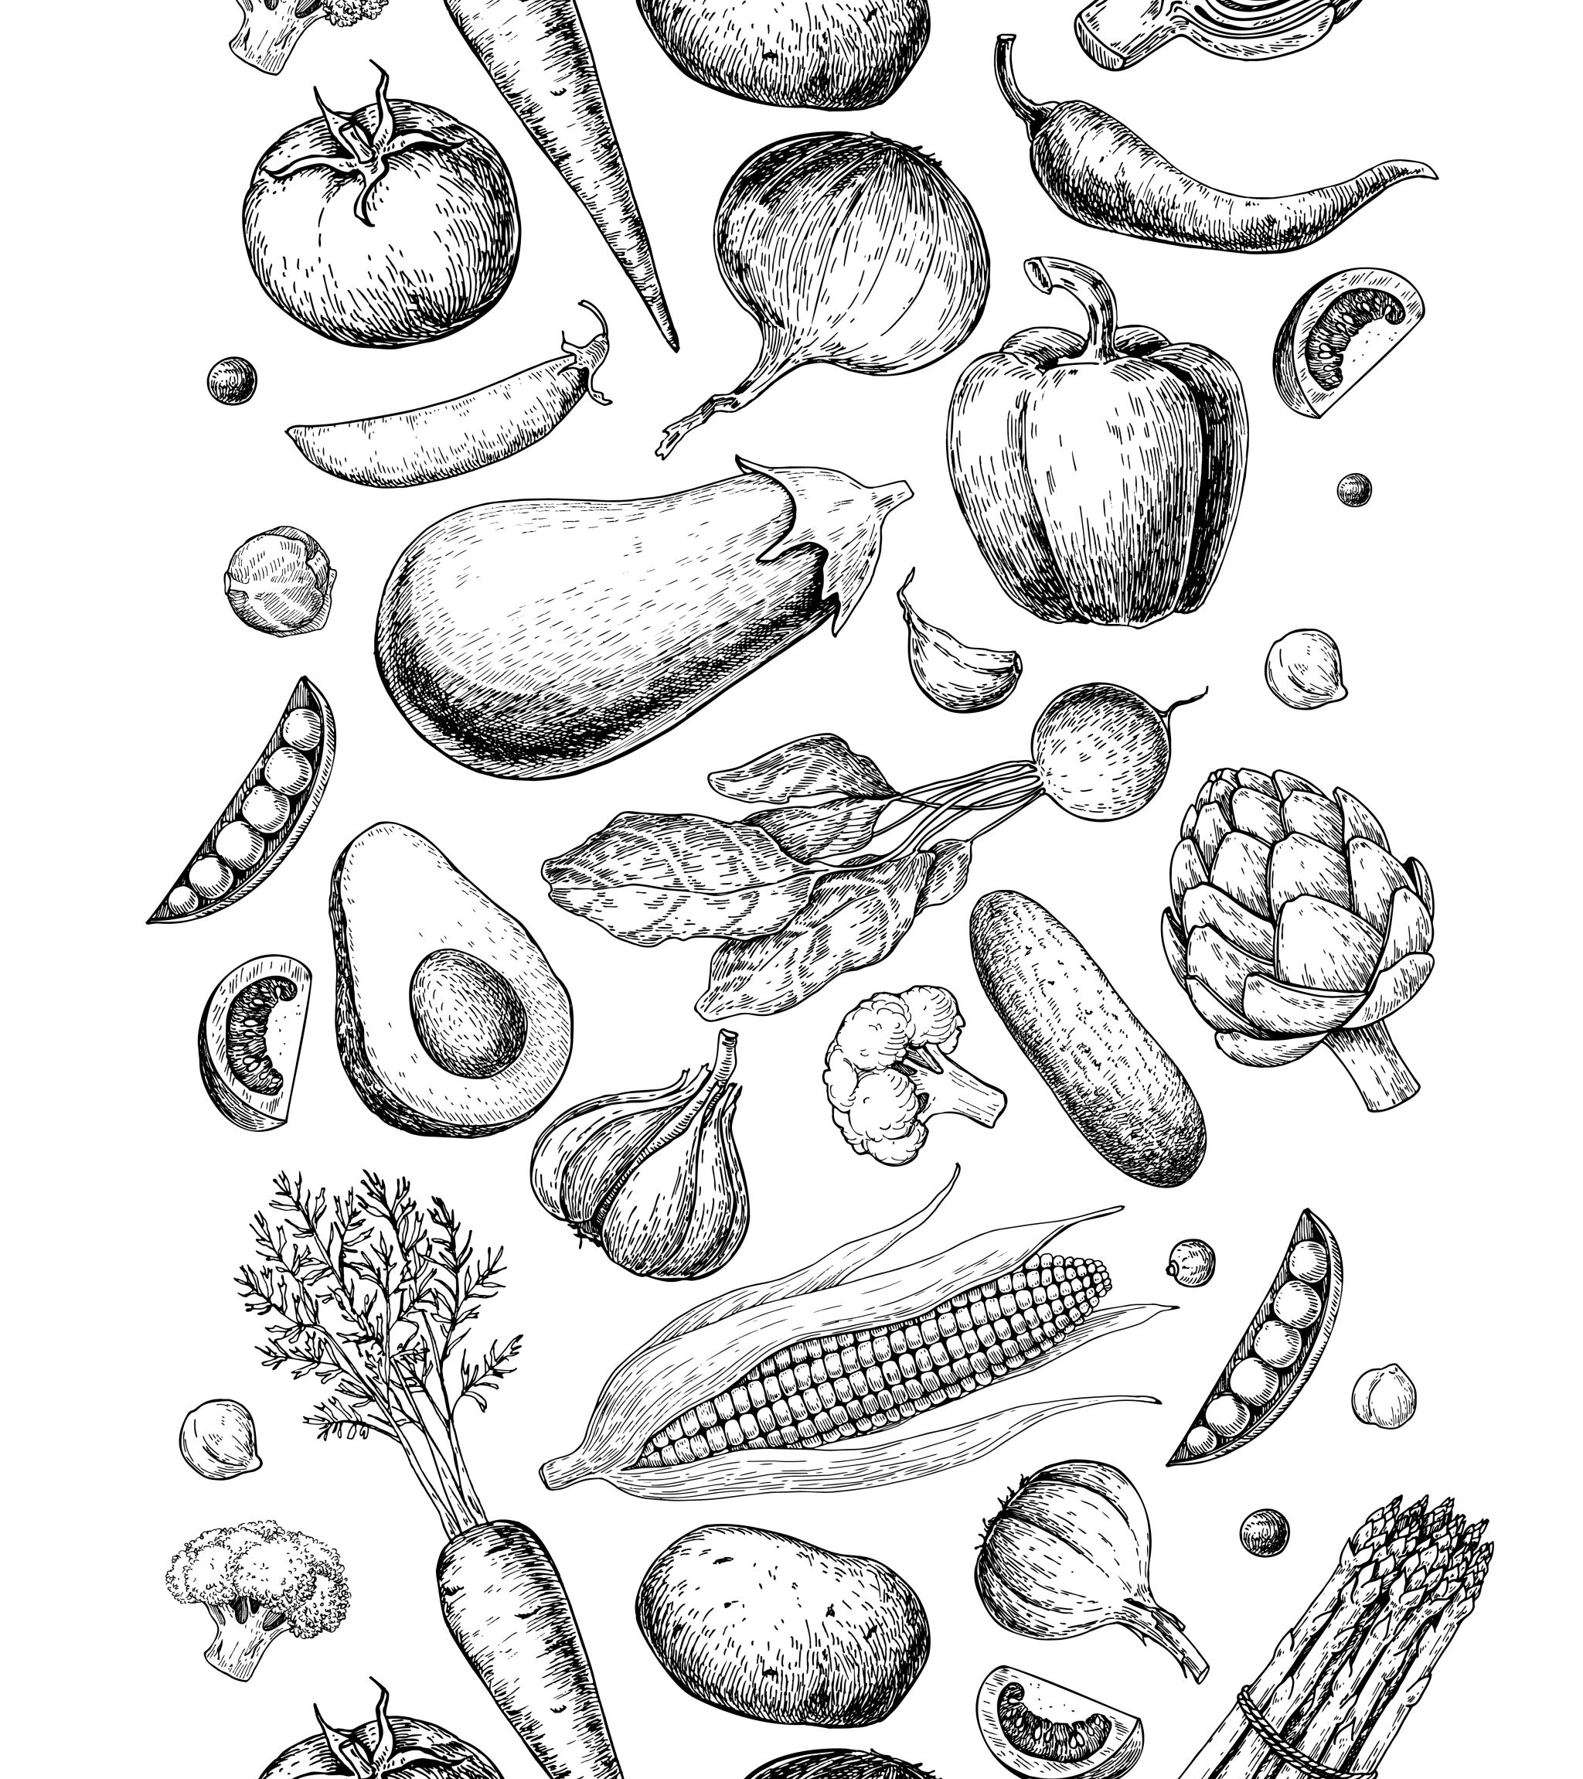
REFERENCES
Klasson, M., Zhang, C., & Kjellstro¨M, H. (2020). Using variational multi-view learning for classification of grocery items. Patterns, 1, 100143. https://doi.org/10.1016/j.patter.2020.100143
Klasson, M., Zhang, C., Kjellström, H., KTH Royal Institute of Technology, & Microsoft Research. (2021). A Hierarchical Grocery Store Image Dataset with Visual and Semantic Labels. In Microsoft Research [Journal-article]. https://kth.diva-portal.org/smash/get/diva2:1322857/FULLTEXT01.pdf
Prabu Selvam, Joseph Abraham Sundar Koilraj. A Deep Learning Framework for Grocery Product Detection and Recognition, 24 May 2022, PREPRINT (Version 1) available at Research Square .https://doi.org/10.21203/rs.3.rs-1431986/v1

